Slide 1
The New World and the Old: Exploration
1400—1650
The Western Shift:
America and Europe

Slide 2
Exploration began with the exploitation of Africa and Asia followed closely by the Americas.
First, the Portuguese began the Age of Exploration;
Second, the Spanish dominated the exploration of the Americas early; followed by the French, then the English.
It is safe to say, that the English far excelled during and after the Age of Exploration—mostly because of their strong Maritime endeavors.

Slide 3
Though all were culpable the Spanish and the English changed the economies, cultures and political make up;
Destroyed native populations and civilizations;
Europeans gained vast stores of wealth, colonization, and geographical advantage over others competing nations.
It enlarged their Navies, economies, and hegemony w/n the Americas and Africa.

Slide 4
Middle Ages ended, Renaissance Princes and Kings became well-educated, ambitious and ruthless (Machiavellian).
They became very powerful financially, lessened the hold of the Church, separated themselves from the aristocracy, and their subjects;
They needed money to do this—colonialism and imperialism was their ticket to financial and global independence.

Slide 5
Source of Funds
Middle East—Spices, silk and cotton fabrics, and medicines—also science and academic research.
Italian City-States had grown economically and intellectually wealthy;
1453, things changed; Ottoman Empire conquered Constantinople—to avoid extortion and taxes, Europeans need a better way to get to the Eastern markets.

Slide 6
The Portuguese sought a way around the Muslims and the Italians; During King John I reign, his son Prince Henry the Navigator began exploring down the West Coast of Africa;
1419, he founded a naval college; he established trading posts and markets in Africa; originally looking for Prester John and a maritime path to the East.
1415, Portugal captured Cueta (Morocco) and Tangiers;
Explored the Madeira Islands, The azores (1427), Cape Verde (1444), and Sierra Leone (1460); established a Slave Fort at Elmina, Ghana (1482).

Slide 7
1488 Bartholomew rounded the Cape of Good Hope; 1498 Vasco da Gama rounded the cape and reached India—a very wealthy venture—now the race was on.
It was not lost on Spain or England that little Portugal based solely on trade had become a Seafaring Empire.
Columbus laid the foundation for Spanish power, the Pope enforced the Treaty of Tordesillas in 1494. (370 miles East of Cape Verde Portugal—west Spain).

Slide 8
15th Century Portugal a maritime dynamo—by mid-16th century Spain supplanted Portugal.
Portugal expelled their Jews and Moors as did the Spanish—this killed their intelligentsia and Middle Class—as it would also do w/Spanish.
1536 Portuguese King introduced the Inquisition, one the House of Aziz ended, the Spanish literally walked in and gained hegemony in the region.
Thus began the “60 years captivity.”

Slide 9
Spain
Spain gained prominence w. unification of Aragon and Castile.
Pope immediately gave Spain the right to all the lands discovered by Columbus—
Spain realized it was not the West Indies, but a far more lucrative and exotic place—Vasco de Balboa discovered the Pacific Ocean (1513).
1519, Magellan realized the globe was larger than first expected. (Herna’n Cortes conquered Aztecs—1531 Pizarro conquered Incan Empire).

Slide 10
Consequences for native Peoples
Disease killed millions—small pox, chicken pox, measles, whooping cough, malaria, and bubonic plague—
Native population decreased from perhaps 50-70 million in 1492 to 5 million by 1700.
Survivors were enslaved, relegated to peon status, forced into conversion or suffered the fate of the inquisition—some even intermarried furthering the demise of certain civilizations—Europeanization was deleterious to Americans.

Slide 11
As Native Population depleted, Spain began to import African Slaves.
Eventually several millions were abducted and sold into the New World;
Most went to the West Indies and South/Central America; less than 4% came to the United States of America.

Slide 12
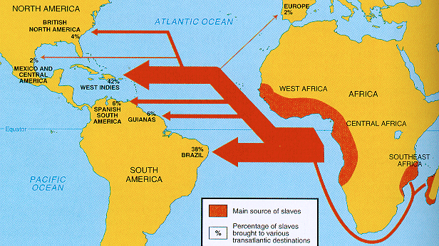
Slave Numbers
14th century to the mid 17th century, the numbers small.
18th—19th century numbers around 50 to 100,000 per year.
38% Brazil
42% West Indies
Only 4% to British North America

Slide 13
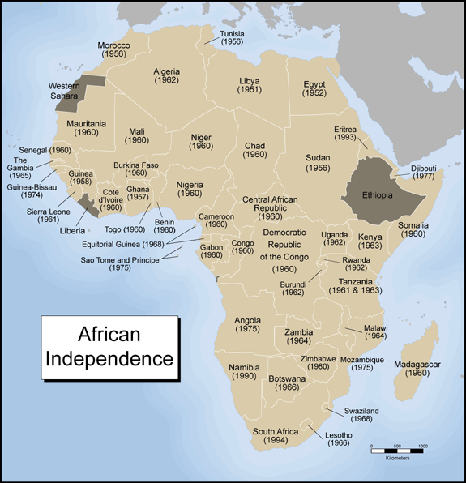
Geographical Regions
Most of the Slaves came from Senegal, Gambia early on;
Then Angola; Then the so-called “Slave Coast” in western Nigeria;
and then from the “Gold Coast” coastline of modern Ghana.

Slide 14
Slave Markets
European Slave Traders were not in the habit of capturing their victims.
They relied solely on African Slave Traders—it was cheaper and less dangerous. Africans already had well functioning and well established slave markets—Europeans just deepened preexisting markets and trade networks.
Local African Chieftains for a price(lease) allowed European slave merchants to construct forts on their coast line for the sole purpose of slave commodities.

Slide 15
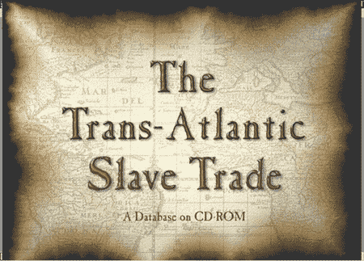
Slave Business
African Rulers sent envoys to European courts soliciting and marketing the slave trade.
Simply, the Europeans neither created the market, dominated the market, nor did they dictate the rules of engagement of the slave trade—but all concerned surely profited from it.
http://www.cambridge.org/us/features/0521629101/assets/screen1.gif

Slide 16
Victims
Most were victims of tribal and nationalist warfare.
At one time we thought there were slave wars—but after years of research, we find that there was huge African initiatives to make money, gain European technology and the Chieftain could rid himself of pesky traditional enemies.

Slide 17
New World Consequences
Intellectually the European World view was challenged; The Bible had not mentioned the New World;
Civilizations and cultures living peaceably, politically, and socially w/o ever hearing about Christ; Or a part of the Great Chain of being;
what did this mean? Rethink God in the world.

Slide 18
Materially, Exploration was—making Spain very wealthy;
Unintended consequence, created huge financial inflation, drove prices skyward, made the poor even more poor and created a huge chasm between the rich and the poor; Seville merchants got rich; destabilized the European economy;
Essentially there was no more Middle Class; It helped finance wars of religion.

Slide 19
French and English
Each were too late to reap the monetary and Gold rewards of the New world;
French began to explore, Canada, Upper Mid West and Mississippi Valley; no gold, but maybe colonize;
Jesuits established numerous missions; helped establish France in the middle of the Fur and trapping market and the Grand Banks Fishing Venture—create issues w/ English later.

Slide 20
France did not foster dissent colonization
By the Late 17th century France tried to exploit the wealth of the Fur Trade using Mercantilist initiatives;
France did use a more liberal form of tolerance with the native peoples.

Slide 21
The English ignored the New World until Elizabeth I’s reign.
Privateers, ie Raleigh, Drake, and Frobisher feasted off Spanish galleons along the Spanish Main;
John Hawkins interposed into the Slave Trade in 1560s and actually created a covert War bx Spain and England—(asiento)
The Lost Colony of Roanoke 1585 (1st attempt @ English colonization).

Slide 22
Jamestown 1607; mine Gold, but quickly became a Joint Venture capital based off a consumerable cash crop—Tobacco; Rice, later cotton.
King James wrote a scathing indictment against tobacco; bad for ones health and it smelled bad.
1619, slavery introduced into North America
Viable familial colonization began with the Congregationalists in 1620—Chartered Massachusetts Bay Colony 1629. (Boston).

Slide 23
Massachusetts allowed for self-government, introduced the first contractual agreement concerning popular government.
They came as family units prepared to settle for longevity—the land and the freedom was their value, not gold or silver. (freedom according to Puritan interpretation)
Mostly a refuge for those who could not conform to the Church of England.

Slide 24
England found very little military and limited commercial value in the beginning; however, the big exception was to use America as a safety valve for dissenters, the disaffected and the disenfranchised;
Did find value eventually in developing other markets such as wool, rice, indigo, shipping and Fishing; Naval Stores and much raw material;
Modernized the banking system in England—Lloyds of London established etc …

Slide 25
Dutch
Became the great trading nation of the 17th century; established the Dutch East India Company in 1602; West East India Co. in 1621.
Granted full independence from Spain in the Treaty of Munster in 1648—part of the Treaty of Westphalia;
Dutch founded a very tolerant Republic; legislated themselves popularly with the States-General w/ Executive Officer (Stadholder).

Slide 26
Dutch a little too tolerant—Portuguese drove the Dutch from Brazil in 1654, they also lost New Amsterdam to the English in 1664 (New York);
The Holy Roman Empire though embroiled in European religious wars, never ventured into the colonization market, or major overseas trading ventures—too land locked and European;
Lack of attempting imperialism had far-reaching effects in the late 19th and early 20th centuries for the German nation—imperial poverty, powerlessness, and Protestantism, eventually spelled doom for the Holy Roman Empire

