Slide 1
The
American
Civil War
(1861-1865)

Slide 2
“As the first total war in history, the Civil War was fought not just by armies but through the mobilization of each society’s human and economic resources. …the freeing of four million slaves was only the most monumental of the war’s many transformations, in both the South and the North.”

Slide 3
South reacted in horror at John Brown’s raid; The Northern abolitionists had provided money and support for the Harpers Ferry raid.
How could northerners condone or praise this type of rebellion—the idea of sponsor mass insurrection and the murder of women and children?
Southerners now forced to defend themselves against their own Slaves armed by northern radicals.
The Union had now become too radicalized and was untenable.

Slide 4
Brown polarized the country socially, economically, and politically.
The election of 1860 was to be the catalyst and harbinger to secession.
Even with all the crises of the 1850s, the Union remained united(geographically); even as early as 1860, most southerners never considered secession.
Southern planters, however, were another matter.

Slide 5
1860 Election
Four candidates: Abraham Lincoln (Republican), Stephen A. Douglas (Democrat), John C. Breckinridge (Democrat), and John Bell (Constitutional Union Party).
Lincoln was seen as the abolitionists party;
Douglas was the Popular Sovereignty Party;
Breckinridge was the Slavocracy Party;(Cuba)
Bell was the Unionist party (ignore the slave issue).

Slide 6
Lincoln won as a northern moderate, byaccepting slavery where it existed, but not allowing it to expand into the western territories.
The South saw Lincoln’s victory as a referendum against all things Southern—their very way of life.
Immediately, South Carolina seceded from the Union followed by other slave states.
Secession was not a unanimous ideology—many rejected it outright as foolhardy—South said it was a contract of states in the Union—others agreed with Webster—no, a contract with the people.

Slide 7
Montgomery, Ala 1861, the Confederate States America were formed—Jefferson Davis (MS) President and Alexander H. Stephens (GA) Vice President—they were considered moderates;
Hoping to attract all of the other slave states to join their cause—wanted to return to the true principles
Of the ‘Founding Fathers.’ Sovereignty must be returned to the states.
Wanted to preserve their social system based on Slave labor. Ironically the war destroyed slavery—Lincoln had sworn to uphold it where it already existed.

Slide 8
After the War, many southerners said the war was over constitutional issues not slavery—during secession, however, southerners knew the war was about slavery:
Alexander H. Stephens— “Our new government is founded up; its foundations are laid. Its cornerstones rest upon the great truth that the negro is not equal to the white man, that slavery, subordination to the superior race, is his natural and moral condition. This our new government is the first in history, the history of the world, based upon this great physical, philosophical, and truth.”

Slide 9
Richmond politicians stated in the Richmond Enquirer,(1864-65) “it is absurd to pretend that a government desirous of restoring the Union would adopt such measures as the confiscation of private property, the emancipation of slaves, the division of a sovereign state without its consent.” (Shelby Foote page 884 Vol II) the struggle must be renewed between generations yet unborn >…

Slide 10
North thought secession foolish and illegal. It was the people who made up the union not individual states;
Thought slavery undermined America’s real mission in the world—as a democratic beacon for all peoples;
It was our exceptionalism that was at stake, not some disingenuous constitutional jargon.
Secession may be illegal, but the southerners had not actually assumed arms against the Union—only made vague legal assertions

Slide 11
Crittenden Compromise (KY) extend the 36—30 line all the way California—above free states, below slave states including Cuba, Mexico, and the entire Caribbean.
Republicans said no—exist where it is, but no expansion;
Southerners, no—must be allowed to expand to all territories—no more room for compromise.
Lincoln agreed to support an amendment to protect slavery in the south—but not expand it.

Slide 12
Lincoln stated that he would not be the aggressor, but that he was bound by the constitution to “hold, occupy, and possess” all federal possessions and territory—the two big installations were Fort Pickens in Pensacola Bay and Fort Sumter in Charleston Harbor.
Lincoln sent word to Charleston, he was going to resupply the fort with food not ammunition or weapons—if you fire upon the ship, then it is you who have started this war.

Slide 13
March Davis sent a telegram to Braxton Bragg commanding rebel forces at Pensacola:
Can you take the fort and when? Not, now and at a terrible cost in lives …
Mayor of Charleston and PGT Beauregard said, South Carolina can take Sumter—
Davis felt he had no choice but to fire the first shot;
April 12th 1861 at 4am the war began ignominiously.

Slide 14
Ironically, it was a bloodless beginning to the bloodiest war in American History.
1st Bull Run (Manassas) made it a long war;
Shiloh made it a bloody;
Sherman made it a total war.
“War is all Hell” William Tecumseh Sherman

Slide 15
North possessed many strengths; population, industry, manufacturing; huge financial coffers (Gold Rush); and already possessed a standing trained Regular Army and Navy.
South did not have to conquer the US to win—stalemate and foreign support; had strong interior lines of supply—it is ironic that at Appomattox in 1865, Southern soldiers had much ammunition, but very little food—home defense and local geographical knowledge—large geographical area.

Slide 16
Southern strategy—hold out for foreign aid by defending the borders—not let North penetrate deep into southern territory;
North initiated Winfield Scott’s “Anaconda Plan” strangle the supplies and arteries of transportation and communication to the South—will whither on the vine.
Bull Run proved a long war, but emboldened the South because of its clear victory.
North ended the notion that the South could be subdued quickly.

Slide 17
In spite of Bull Run, neither the South nor the North had the logistics to follow up quickly.
North (Grant) won key victories in the West (Fts Henry and Donelson) opened up waterways into the heart of the South.
Shiloh proved a bloody war, but Grant gets the win for this battle—again the western boundaries of the South are quickly falling under Northern control.

Slide 18
Robert E. Lee, quirk of fate, took command of the Army of Northern Virginia and won important battles early—Seven Days Campaign, White Pines and the Peninsula(actually losses), then won another big victory at the Battle of Second Bull Run.
Lee kept a much larger force and its commanders Mc Clellan etc … At bay for three years extending the war.
Though much of the Generalship was equal, Lee did have Thomas “Stonewall” Jackson until after the Wilderness campaign. Lincoln continued to search for the right General—advantage Lee.

Slide 19
Feeling emboldened, Lee invaded the North—he and McClellan met at Sharpsburg MD, Antietam Creek.
McClellan had Lees battle plans—both claim victory-though Lee did retreat back to Virginia.
North lost any initiative due to extreme casualties and McClellan’s penchant for not following up.
Lincoln had what he wanted a victory in which to hang the Emancipation Proclamation

Slide 20
Though Antietam officially ended any chance of foreign intervention, the North suffered heavy setbacks in 1863 until Gettysburg.
Burnsides lost badly at Fredericksburg and Hooker was routed at Chancellorsville and Grant was stalled outside of Vicksburg.
Lincoln had to combat, draft riots, copperheads(southern sympathaziers-Vandallingham)—Lee once again invaded the North; Lost at Gettysburg, Grant captured Vicksburg and defeated Bragg at Chattanooga

Slide 21
Hardship and Suffering
  War corroded discipline and social order
  1863: Richmond bread riots
“The war was a cancer that ate away not only at southern society but at the southern soul itself.”

Slide 22
The Union Home Front
Government Finances and the Economy
  Measures to raise money were comprehensive
  Western development encouraged in absence of Southern opposition
A Rich Man’s War
  Corruption and fraud were rampant
  Perceptions of moral decline became epidemic

Slide 23
Gone to Be a Soldier
Discipline
  Behavior standards came as a shock to many soldiers
Camp Life
  Disease and medical care were constant problems
  Concerns about decline of morality

Slide 24
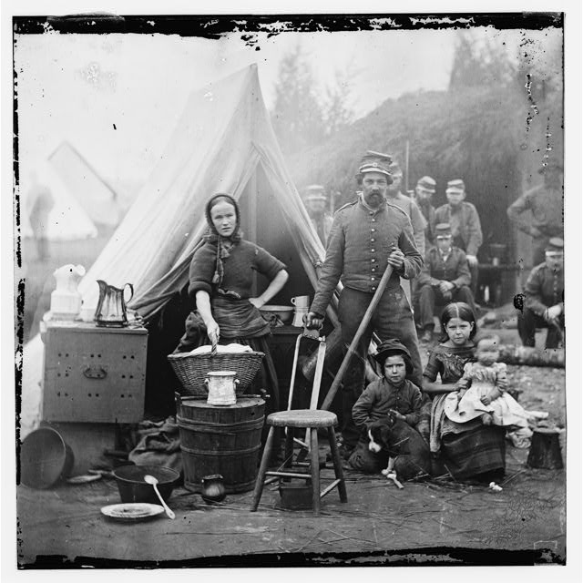
Camp Life
This was a common occurrence and scene for both Union and Southern camps—not as prevalent as in earlier wars but still very much part of the camp landscape

Slide 25
The Changing Face of Battle
  Impact of technology was immense
  Strength of the defense aided by new artillery pieces
  Soldiers’ hardening outlook as a result of war of attrition
Hardening Attitudes
  Reality of combat did not fit expectations for a
  short war

Slide 26
The Union’s Triumph
Confederate High Tide
  Battle of Gettysburg (July 1863) represented the South’s best chance at a major victory on northern soil
Lincoln Finds His General
  Capture of Vicksburg by Gen. Grant catapulted
  him to stardom
  Grant became commander of all Union armies
  in 1864

Slide 27
War in the Balance
  1864 election in question until Sherman’s capture of Atlanta
  Lincoln re-elected over McClellan
  Thirteenth Amendment abolishing slavery passed in 1865—sent to states for ratification
The Twilight of the Confederacy
  Confederacy abandoned slavery in 1865 in order to enlist slaves into the armies
  Sherman’s march to the sea broke the South’s will
  to fight
  Lee surrendered, April 9, 1865

Slide 28
The Impact of the War
Cost of war was immense, both economically and socially
620,000 killed
Spurred industrialization
Impact on worldwide cotton trade
Spiritual toll of the war would last for decades

